Slide 1


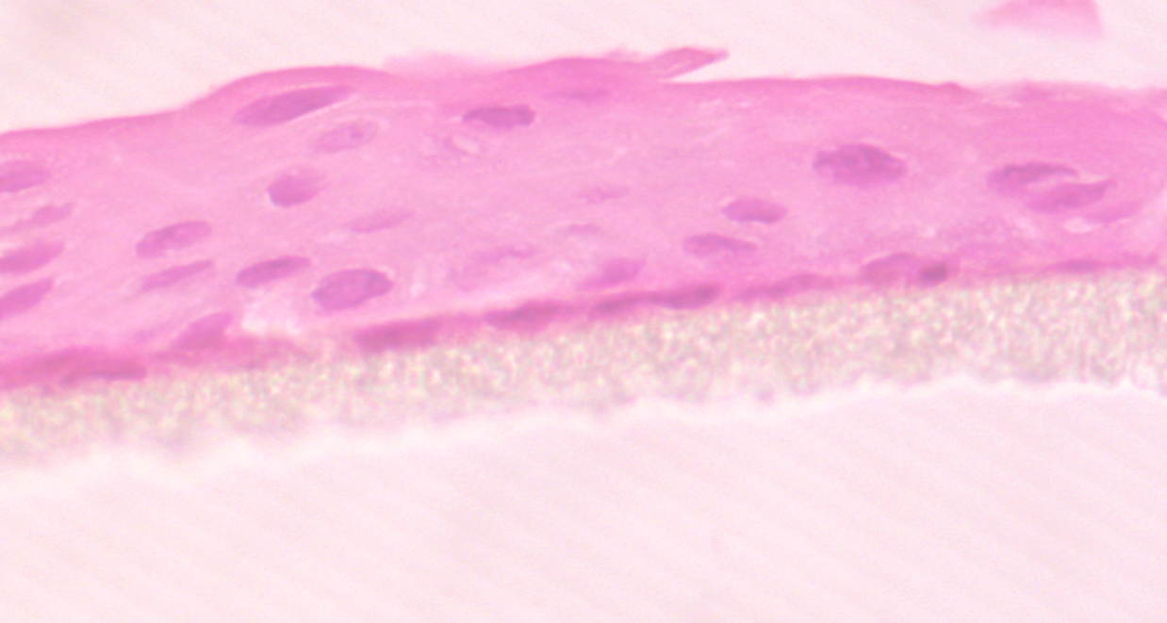
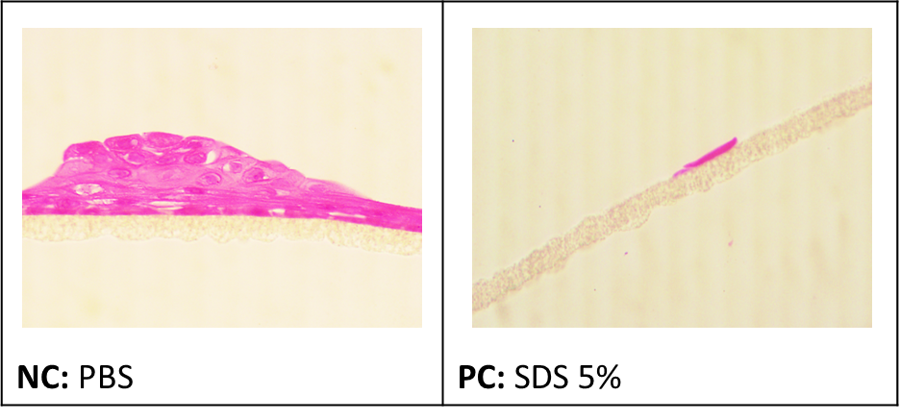
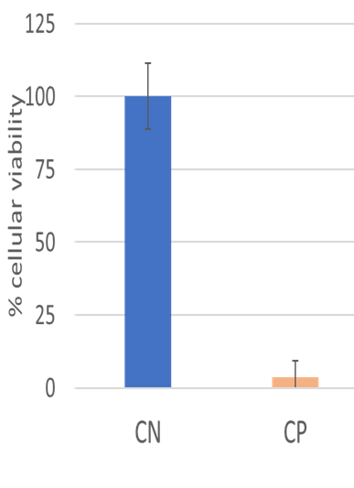
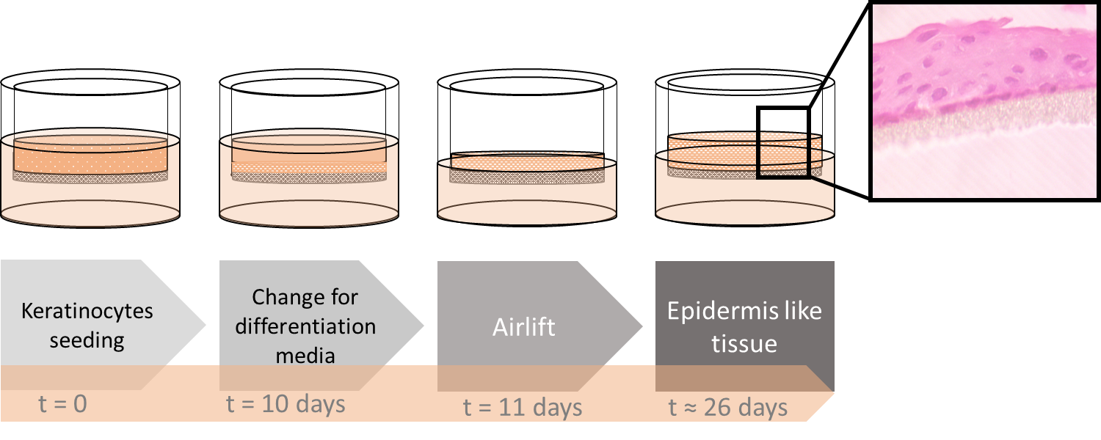
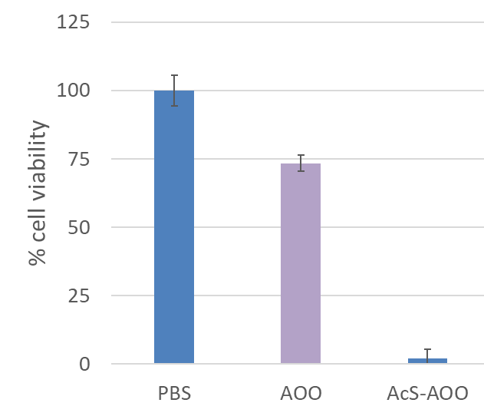
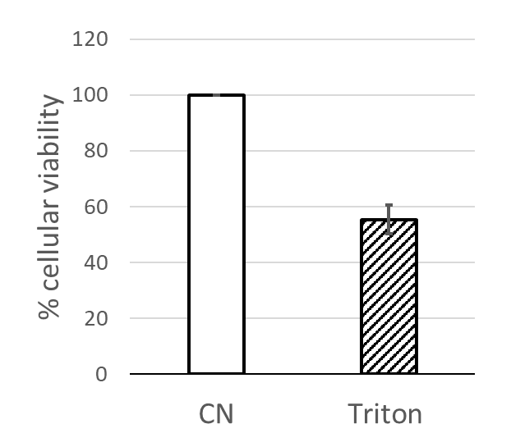
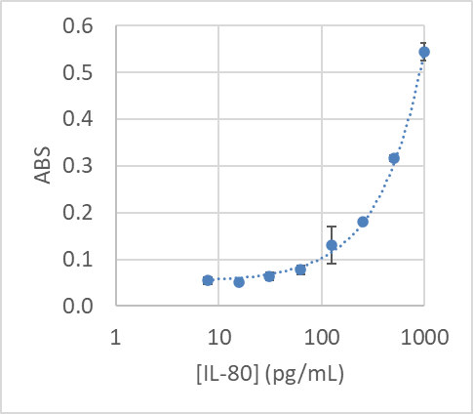

Development of a canine epidermis equivalent model for evaluation of sensitization
Marques M.¹, Nunes J.², Ustymenko B. ¹, Lagoa, T . ³, Fialho L.^{3,4}, Martins L.^{3,4}, Burke A.^{2,5}, Souza E.F.⁶, Filho C.M.C.⁶, Craveiro A.C.⁶, Costa A.R. ^{1,7}, Branco S.^{3,4}, Antunes C.M.^{1,7}
A multilayer (3-4 cell-layer thick) of canine keratinocytes was developed in air-lift culture, exhibiting functional characteristics of the normal epidermis.
Background
Canine atopic dermatitis (cAD) is a genetic-predisposed allergic and pruritic inflammatory skin condition, associated with sensitization to environmental allergens. A histotypical cell cultured-derived tissue may be used to replace animal testing and are is imperative to avoid armful, drawn-out tests to assess chemicals for their capacity to disrupt skin or cause sensitization.
The aim of our study was to develop a histotypical canine epidermis equivalent, that could be used for the assessment of skin irritation and sensitization, useful in studies of cAD pathogeny and pharmacology.
Results
1. A stratified epidermal-like tissue was originated, confirmed by histological analysis
3. The model responded adequately to the positive (5% SDS) and negative (PBS) controls of the irritation test
¹Institute of Earth Sciences - ICT,
²Department of Chemistry, School of Sciences and Technology, University of Évora, Portugal;
³Mediterranean Institute for Agriculture, Environment and Development – MED;
⁴Department of Veterinary Medicine, School of Sciences and Technology, University of Évora, Portugal;
⁵Institute for Research and Advanced Learning – LAQV;
⁶BRinova Biochemistry Lda. , Évora, Portugal;
⁷Department of Health and Medical Sciences, School of Health and Human Development, University of Évora, Portugal.
⁸Curae Vet Veterinary Clínics, Estremoz and Vila Viçosa, Portugal.
NC
PC
2. The model showed an adequate impermeabilization after 0.1% Triton X-100 exposure for 4h
4. The model responded adequately to the positive [20% salicylic acid in AOO (acetone and olive oil 4:1)] and negative (PBS and AOO) controls of the sensitization tests
Methods
Canine keratinocytes progenitor cells were seeded in air-lift culture, using an adapted version of the CELLnTEC™ protocol.
Irritation and sensitization protocols were adapted from human equivalent validated tests. IL-18 was measured by ELISA.
For histological analysis, samples fixed in neutral-buffered formalin and paraffin sections were routinely processed for biopsies and stained with hematoxylin and eosin.
Acetilsalicilic acid (40%) induced 95% reduced viability, with IL-18<30 pg/mL, showing to be irritating but not a sensitizering agent, as expected.
NC
Conclusions
This is a promising canine epidermis model that can be used for the study of skin-derived cAD triggering factors, and in the development and evaluation of new drugs for topical applications.
Acknowledgements: Project co-financed by the European Union Fund – Portugal 2020, Alentejo 2020 – Ref. 03/SI/2017 (ALT20-03-247-FEDER-033578).

