Slide 1




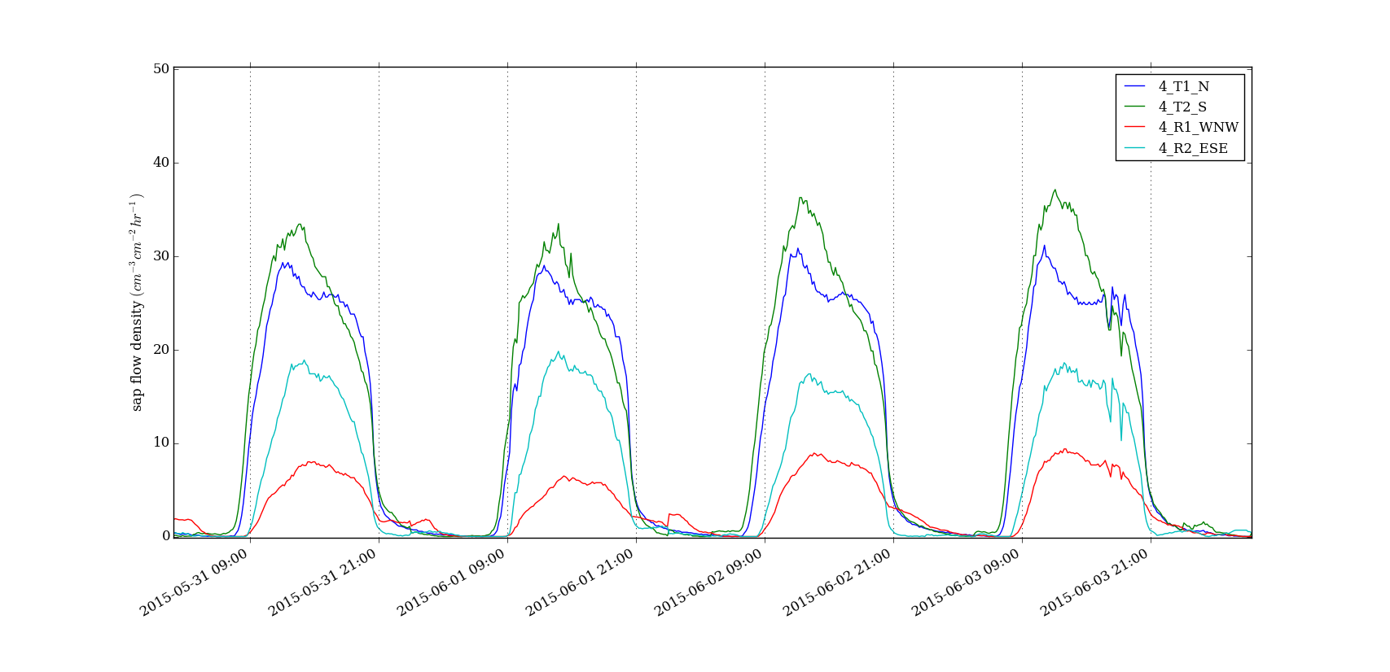
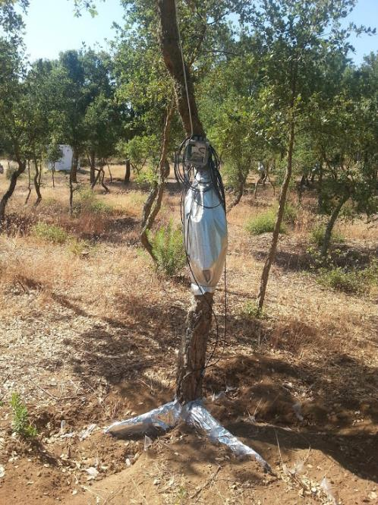
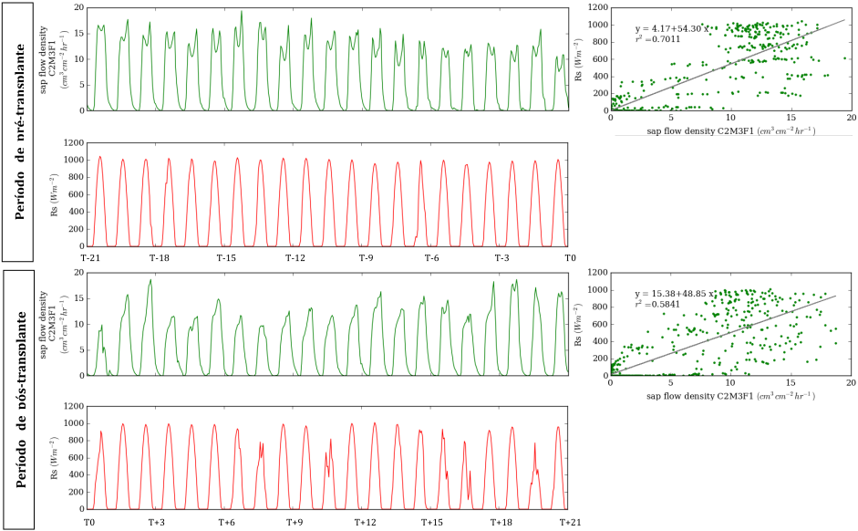
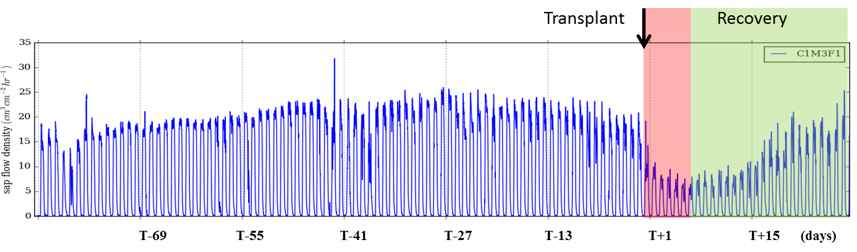
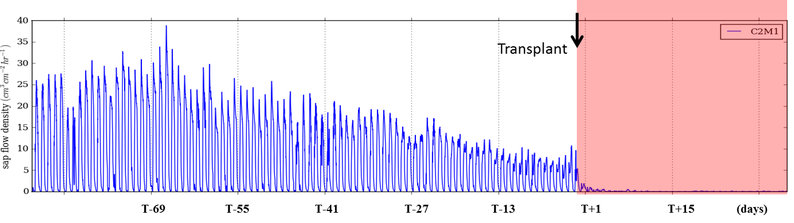
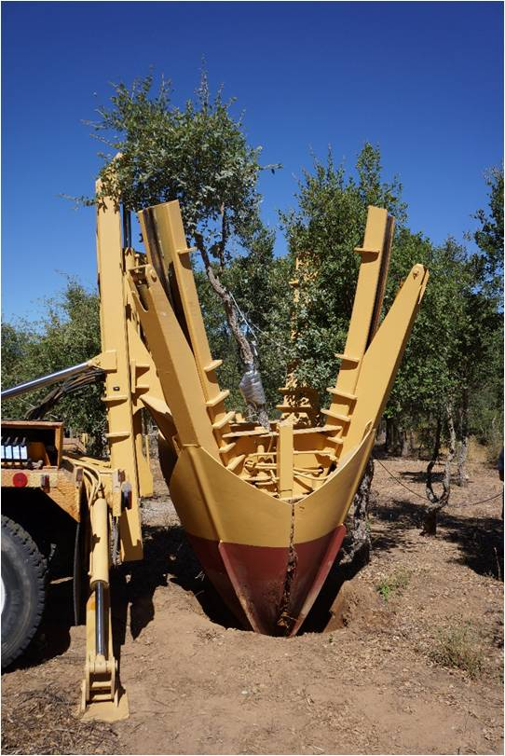
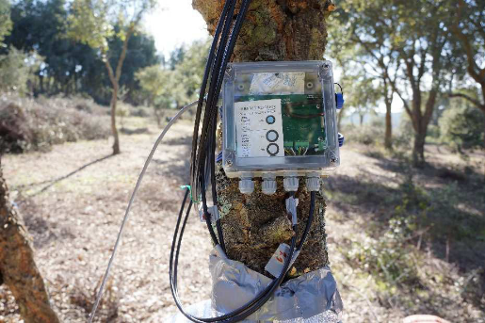
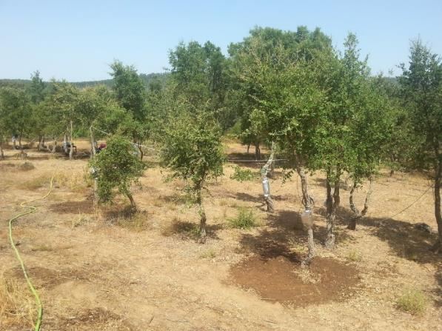
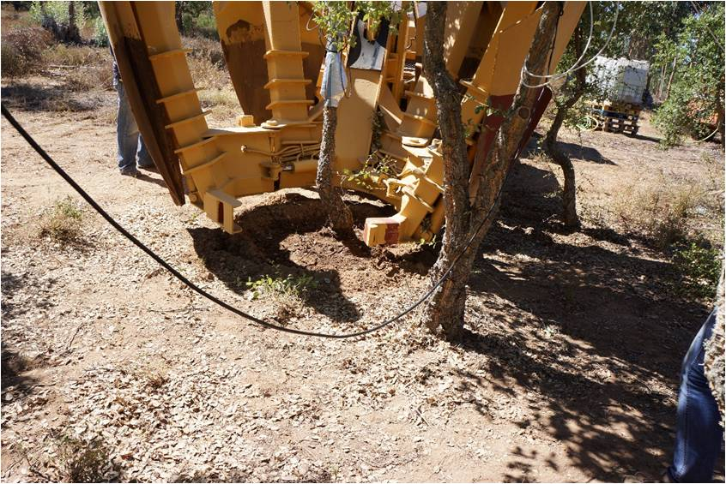






Cork Oak Transplant: A New Reality?
A Physiological Approach to Maximize Success Rate
Dinis C*.⁽¹⁾, Valverde P.⁽¹⁾, Camilo-Alves C.⁽¹⁾, Ribeiro N.A. ⁽¹⁾ , Vaz M.⁽¹⁾,
¹⁾ ICAAM - Instituto de Ciências Agrárias e Ambientais Mediterrânicas, Departamento de Fitotecnia, Universidade de Évora, Pólo da Mitra, Ap. 94, 7002-554 Évora, Portugal; * cd@uevora.pt
World Congress Silvo-Pastoral Systems in a changing world:
functions, management and people
Évora, Portugal, 27-30th
September 2016
QUESTION
Results and Discussion
It is possible to maximize success rate of cork oak transplant with specific treatments and with adjusted ecophysiological monitoring?
Evaluation of roots and trunk sap flow behavior demonstrate that roots are delayed from trunk due to the continuum soil-tree-atmosphere
Continuous recording of sap flow and the correlation with solar radiation identifies anomalies in the dynamics of sap flow and a way to diagnose the status
of the tree and infer
the short-term success
or failure of the
transplantation
process
Sap flow continuous monitoring combined with leaf water potential and stomatal conductance is a suitable methodology to apply to the transplant process, giving real time responses of the trees to impacts
90% of transplant success
Not significant differences were observed between treatments
Irrigation before, during and after transplant is crucial for survival rate
Introduction and Objectives
Tree transplant promote a water imbalance at tree level caused by depression in water uptake, thus predisposing trees to water stress. The success of transplantation depends on physiological recover capacity of tree water status. In order to improve transplantation success, available commercial products to reduce transpiration and an irrigation/fertirrigation protocol were tested. Real time monitoring eco-physiological parameters such as water potential and sap flow has a huge advantage allowing a fast and quick observation of stress impact during transplant operation and recovery. This study aimed to analyze if current transplant methodologies and technologies available in the domestic and international markets can be successfully applied in cork oak tree transplants, of medium to large sizes in the Montado ecosystems and to infer its success rate in early stages when coupled with ecophysiology monitoring. This Poster presents some of the results included in the research project.
Methodology
Study site: SW Portugal Sample: 10 cork oak trees (ø between 23 and 47 cm)
Treatments to limit canopy transpiration and to improve root systems prior to transplant were addressed (mycorrhiza, fertilizer, foliar antitranspirant)
Tree’s transplants were performed with a truck-mounted hydraulic spade transplanter
Tree ecophysiological indicators (sap flow, leaf water potentials (pre-dawn and midday) and stomatal conductance) and climatic indicators were investigated
Water stress avoidance practices were established to promote post-transplant tree status recovery, including irrigation to match average daily accumulated sap flow
Physiological status monitoring before, during and after transplant operation
Cork oak transplant success
Recovery
Cork oak transplant insuccess
Treatments
Irrigation
Antitranspirant
Ecophysiological monitoring
Ecophysiological monitoring
Transplant operation
Conclusions
By following the proposed methodology the sampled cork oak trees exhibited a transplant success rate of 90% during the experimental period (1 year)
Transplant operations were considered successful when the tree's water uptake inferred from sap flow exhibited a high correlation with solar radiation and returned to its undisturbed or pre-transplant water potential gradients in the following 2 to 3 weeks
Real-time sap flow monitoring provides reliable results to establish an automated assessment method of tree status during Q. suber transplant operations.
In case of success, the sap flow measurement methodology allows to identify the time elapsed after transplantation from which the tree recovers its normal transpiration thresholds and response
References
Abou-Khaled, A., Hagan, R.M., Davenport, D.C., 1970. Effects of kaolinite as a reflective antitranspirant on leaf temperature, transpiration, photosynthesis, and water-use efficiency. Water Resour. Res. 6, 280–289. http://doi:10.1029/WR006i001p00280
Besson, C.K., Lobo-do-Vale, R., Rodrigues, M.L., Almeida, P., Herd, A., Grant, O.M., David, T.S., Schmidt, M., Otieno, D., Keenan, T.F., Gouveia, C., Mériaux, C., Chaves, M.M., Pereira, J.S., 2014. Cork oak physiological responses to manipulated water availability in a Mediterranean woodland. Agricultural and Forest Meteorology 184, 230–242. http://doi:10.1016/j.agrformet.2013.10.004
Bugalho, M.N., Caldeira, M.C., Pereira, J.S., Aronson, J., Pausas, J.G., 2011. Mediter-ranean cork oak savannas require human use to sustain biodiversity and ecosystem services. Front. Ecol. Environ. 9 (5), 278–286.
Dinis, C., Surovy, P., Ribeiro, N., Machado, R., & Oliveira, M., 2015. Cork Oak Seedling Growth under Different Soil Conditions from Fertilisation, Mycorrhizal Fungi and Amino Acid Application. Journal Of Agricultural Science, 8(1), p55. doi:http://dx.doi.org/10.5539/jas.v8n1p55
Dinis C. 2014, Cork Oak (Quercus suber L.): A Structural-Functional3D Approach. Doctoral Tesis. Universidade de Évora. Portugal.
Granier, A. 1985. Une nouvelle methode pour la mesure du flux de seve brute le tronc des arbres. Ann. For. Sci. 42:193-200.

