Slide 1
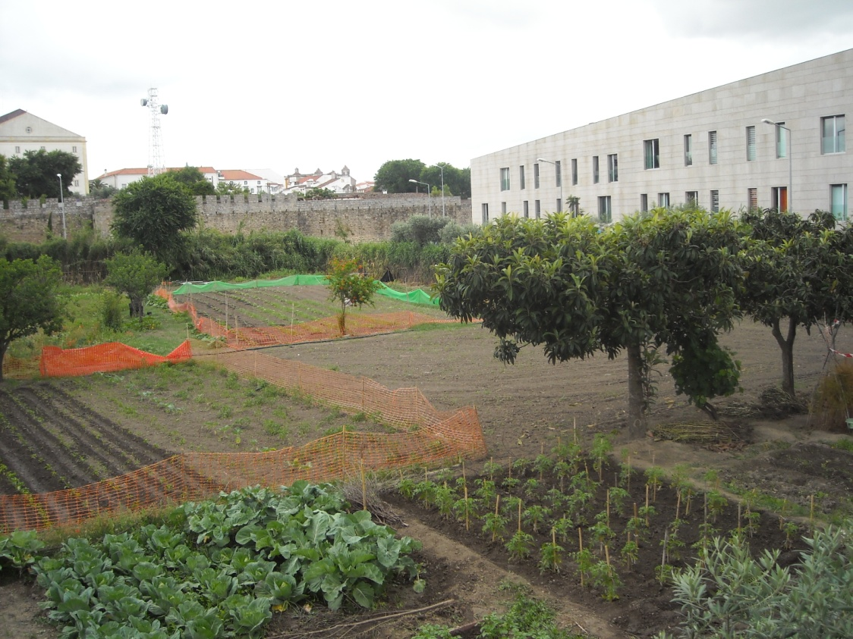
The ethics and the aesthetics of the allotment gardens
Rute Sousa Matos
CHAIA – University of Évora - Portugal

Slide 2
The ethics and the aesthetics of the allotment gardens
Introduction
The landscape reflects the free creative action of Man upon nature.
The human action aims at beautifying nature, as well as exploring the usefulness of the landscape
Ethics
Aesthetics
Landscape

Slide 3
The ethics and the aesthetics of the allotment gardens
Why study allotment gardens?
Agricultural practice within the urban space is a way to establish a relationship between production, protection and recreation.
It’s a central activity if we consider the energy and food crisis present in our daily lives (with the expectation of an increase on both items in the near future)

Slide 4
The ethics and the aesthetics of the allotment gardens
Objectives
Considering the idea of space as a vital experience crucial in the concept of landscape it is our aim to address, ethically and aesthetically, allotment gardens as a space of the landscape including that living experience (even from an observer’s point of view).

Slide 5
The ethics and the aesthetics of the allotment gardens
Why are allotment gardens an ethic reality?
According to Ferriolo (2002),
Landscape is an ethical reality, field of action, space of associated human life: it is a possible reality of resolutions and transformations. Its essence belongs to practical philosophy, so to ethics.
Allotment gardens, as any other landscape are also an ethical reality.

Slide 6
The ethics and the aesthetics of the allotment gardens
Food of the future -
http://www.youtube.com/watch?v=V2pn6BHVRqE – 20th Aug 2011

Slide 7
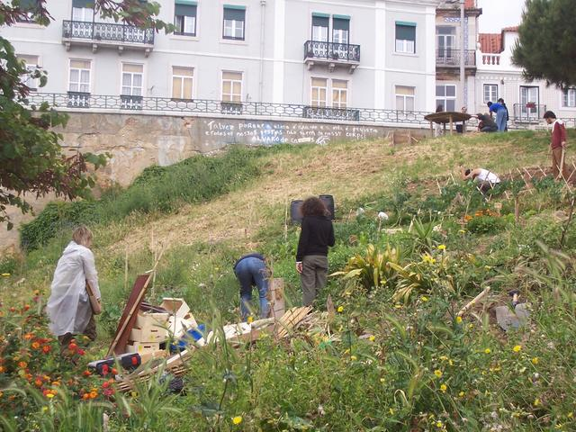
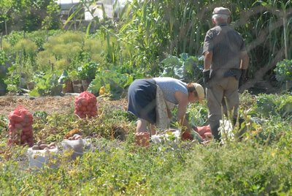
The ethics and the aesthetics of the allotment gardens
Allotment gardens are seen as an ethical reality in which Man coexists
Ethics

Slide 8
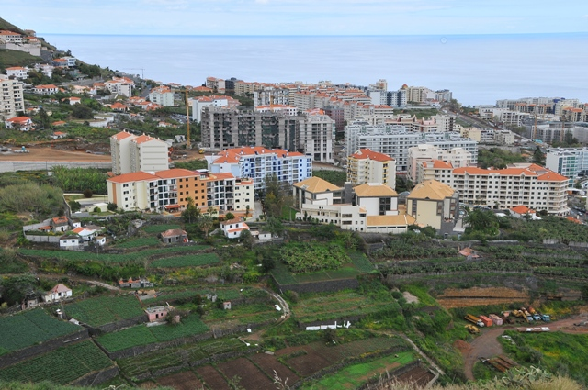
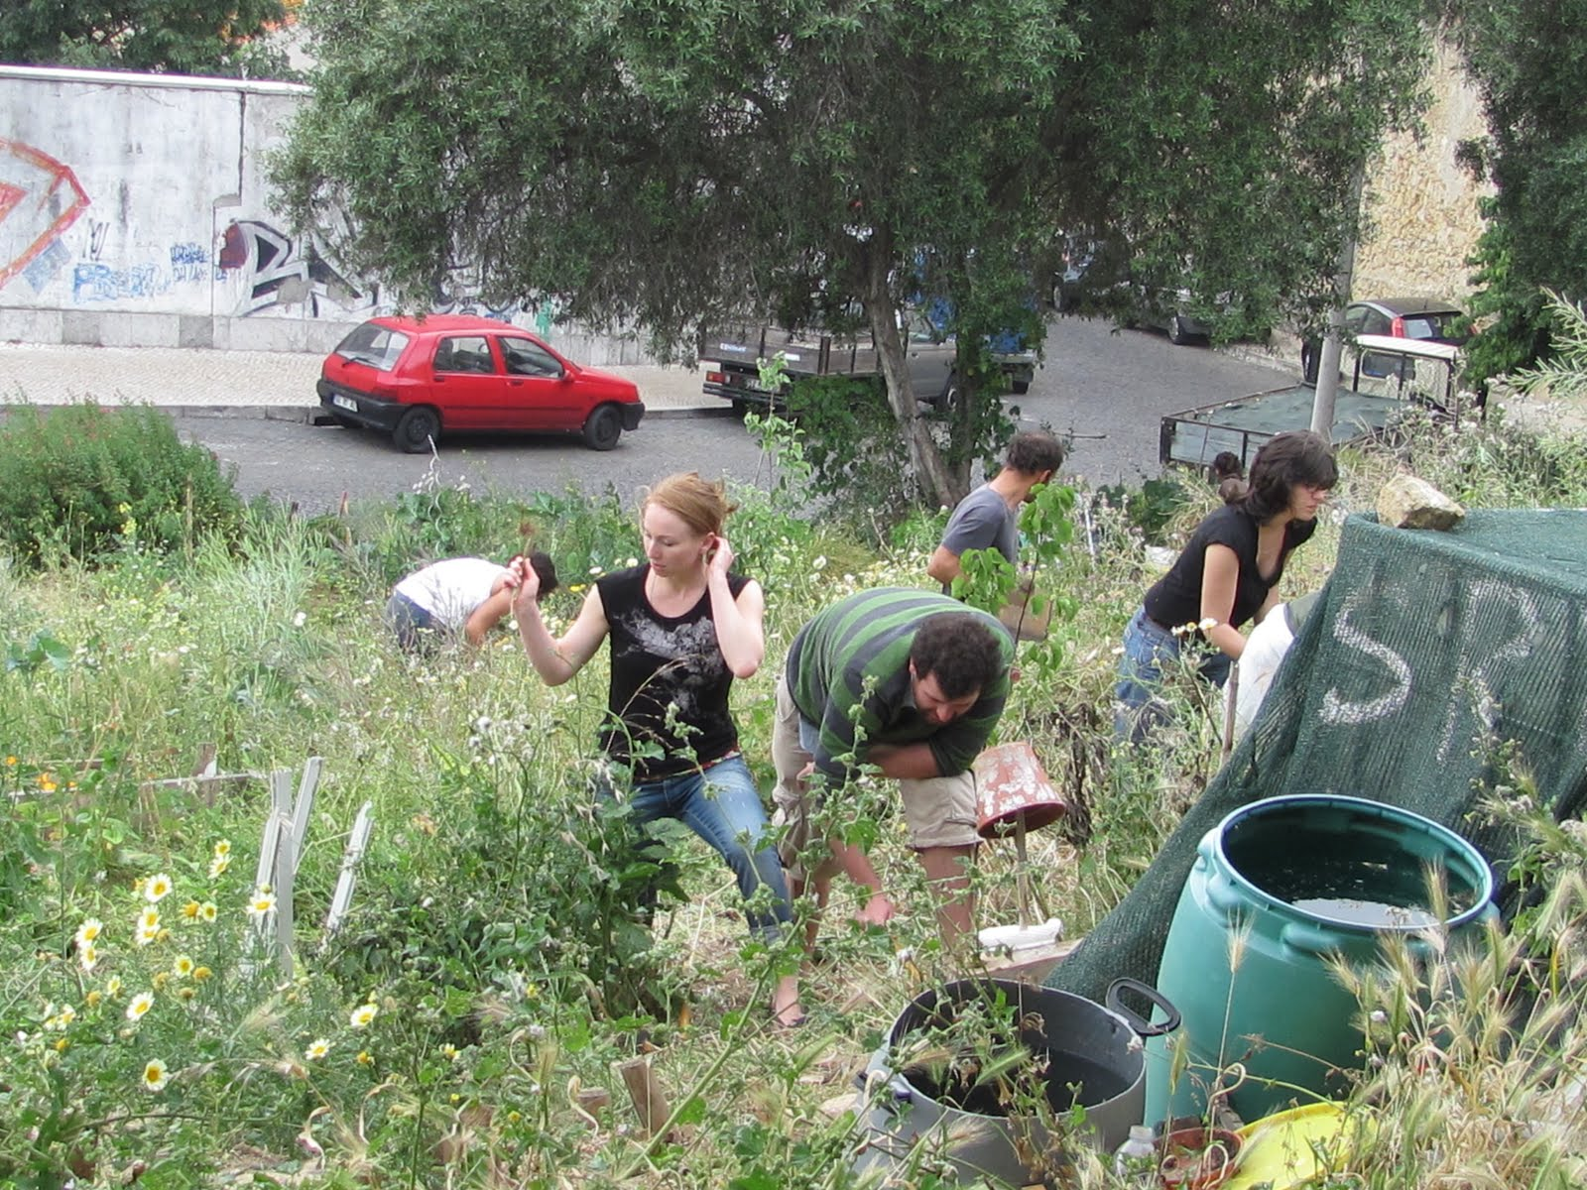
The ethics and the aesthetics of the allotment gardens
Ethics
Allotment gardens are a comprehensive and an inclusive concept .

Slide 9
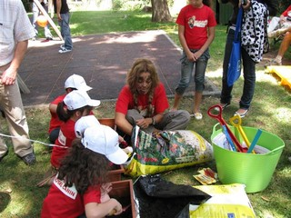
The ethics and the aesthetics of the allotment gardens
Ethical benefits related to allotment gardens
Social benefits

Slide 10
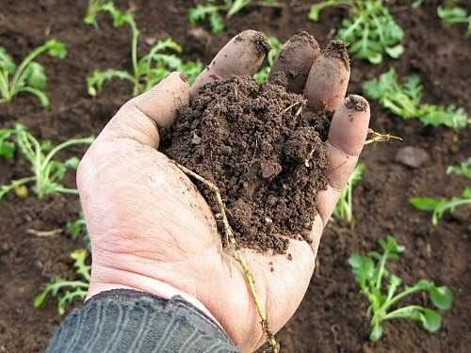
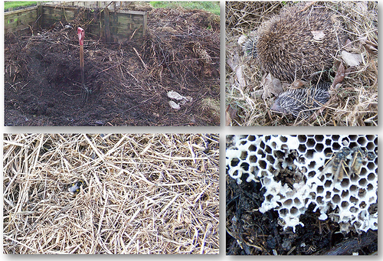
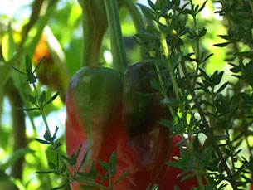
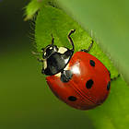
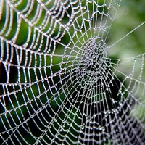
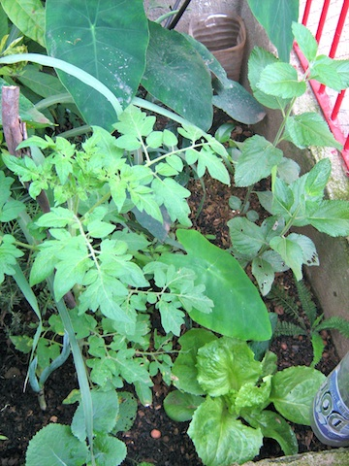
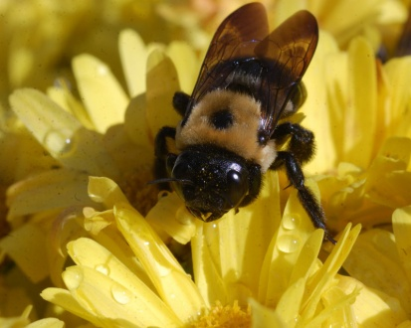
The ethics and the aesthetics of the allotment gardens
Ethical benefits related to allotment gardens
Environmental benefits and biodiversity

Slide 11
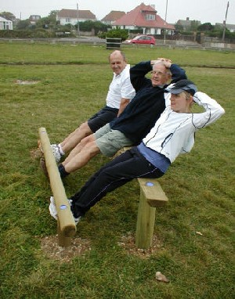
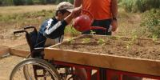
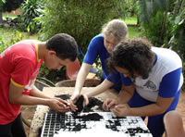
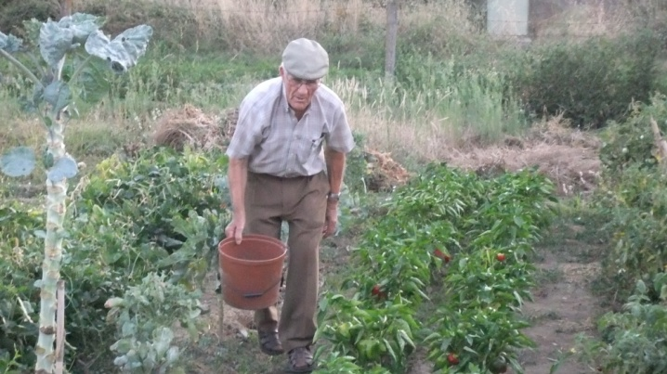
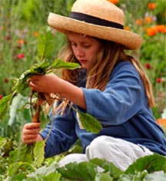
The ethics and the aesthetics of the allotment gardens
Ethical benefits related to allotment gardens
Health and emotional benefits

Slide 12
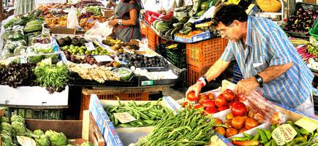
The ethics and the aesthetics of the allotment gardens
Ethical benefits related to allotment gardens
Economical benefits

Slide 13
The ethics and the aesthetics of the allotment gardens
Why are allotment gardens an aesthetical reality?
According to Assunto (1973),
Landscape is an aesthetical reality that we contemplate living in it. (Rosario Assunto, 1973).
Allotment gardens, as any other landscape are also an aesthetical reality.

Slide 14
The ethics and the aesthetics of the allotment gardens
Peach orchard song -
http://www.youtube.com/watch?v=3Y6yyHGw404 – 19th Aug 2011

Slide 15
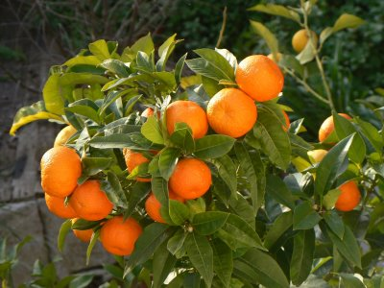
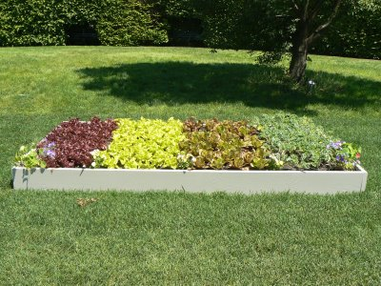
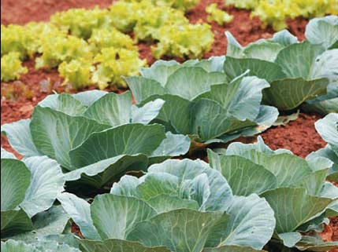
The ethics and the aesthetics of the allotment gardens
Aesthetical value of allotment gardens
Allotment gardens are always an aesthetic reality. It is always a life experience even when it is just for contemplation.

Slide 16
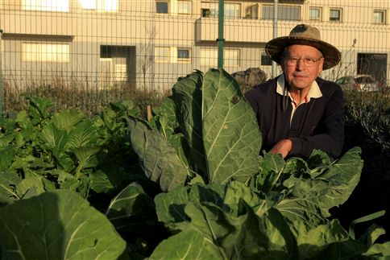
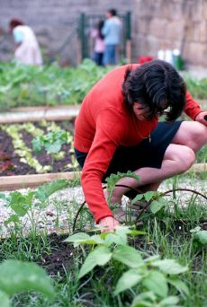
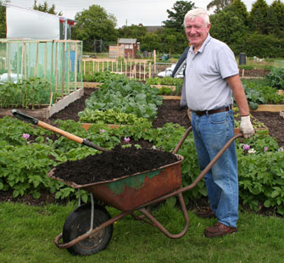
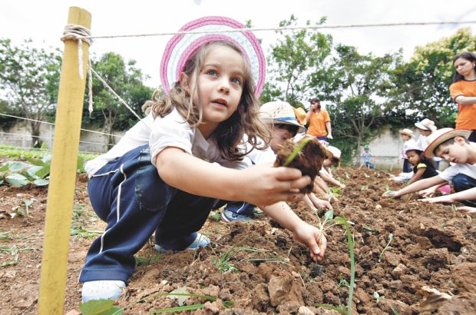
The ethics and the aesthetics of the allotment gardens
Aesthetical value of allotment gardens
Allotment gardens are an enriched life experience

Slide 17
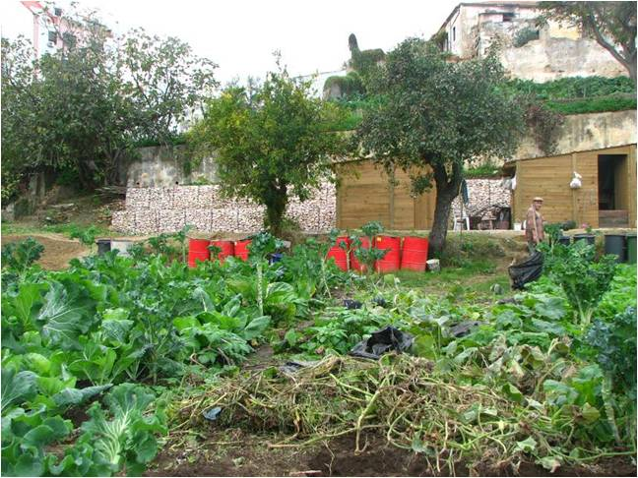
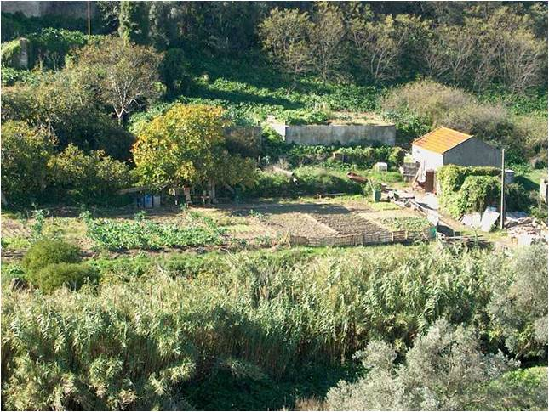
The ethics and the aesthetics of the allotment gardens
Aesthetics
The importance of these spaces has been recognized
by the Lisbon City Hall. It has inventoried, legalized
regulated and promoted these spaces as spaces of great value
within the system of open
spaces and within the green structure of the city

Slide 18
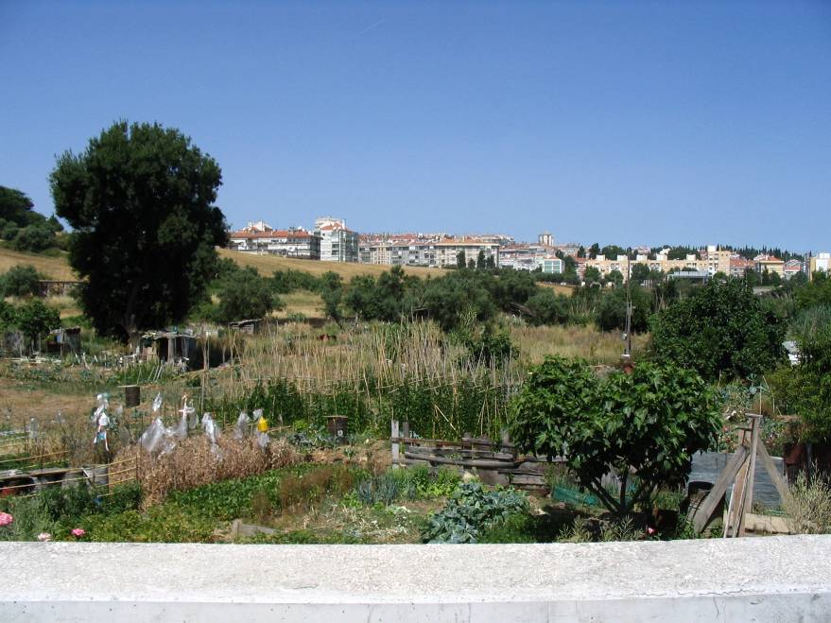
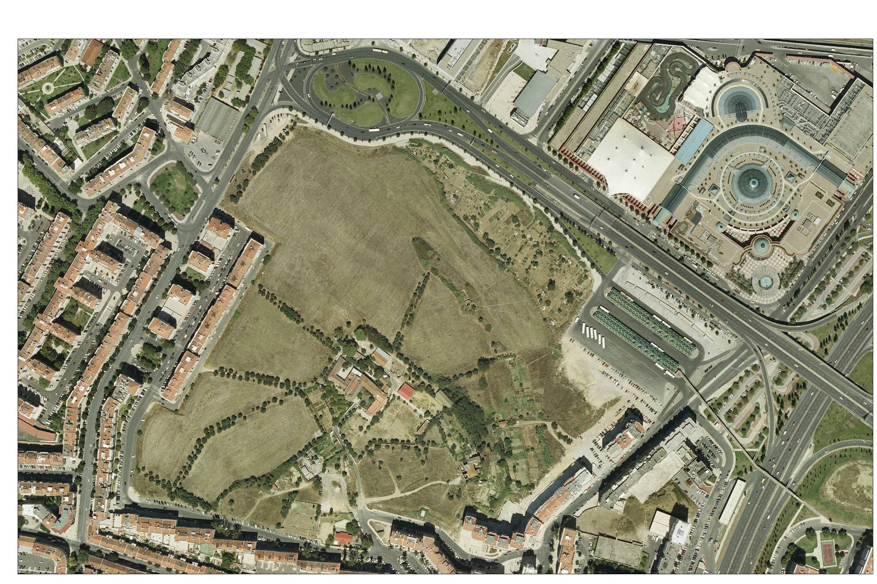
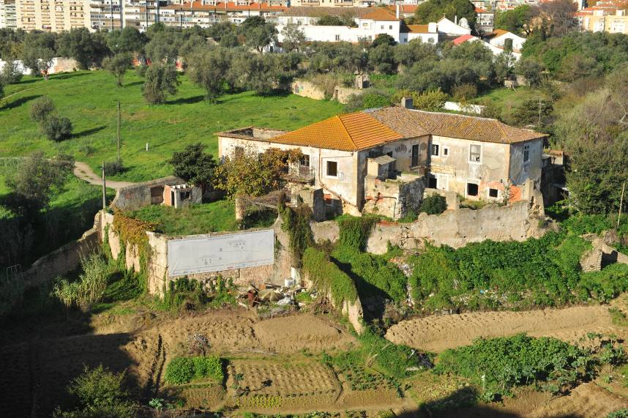
The ethics and the aesthetics of the allotment gardens
Aesthetics
Allotment gardens in Quinta da Granja…
Quinta da Granja – Original situation – Phase 1

Slide 19
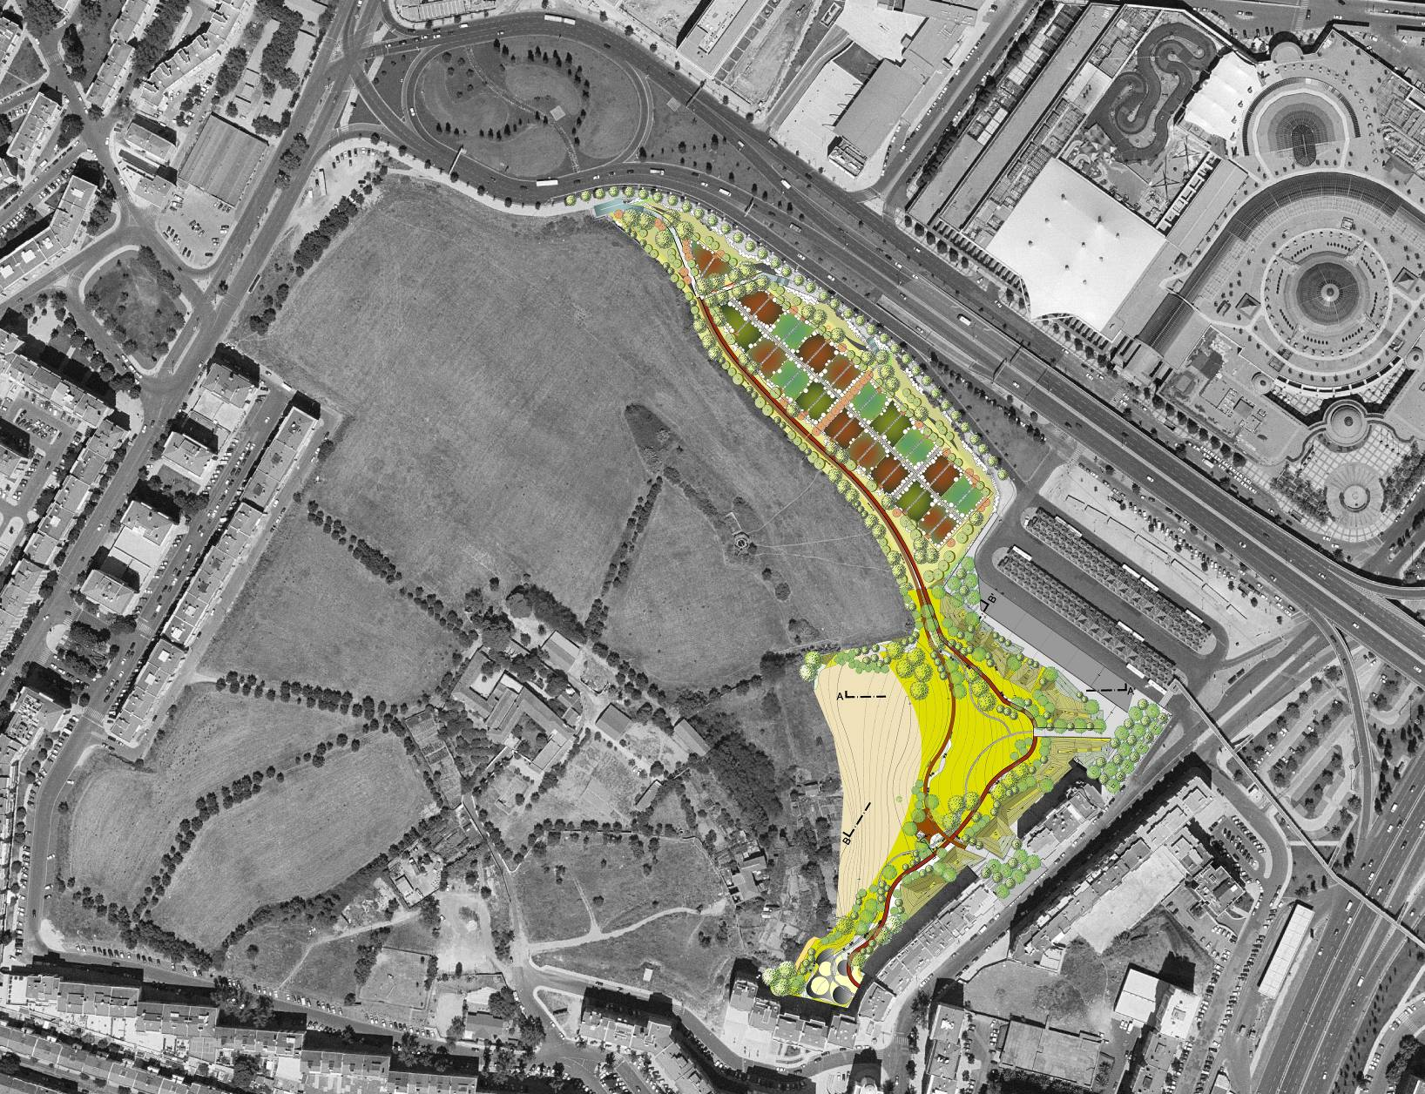
The ethics and the aesthetics of the allotment gardens
Aesthetics
…are now included in The Urban Park of Quinta da Granja, as a result of a landscape design.
Quinta da Granja – Urban Park – Inclusion of allotment gardens in the urban park.

Slide 20
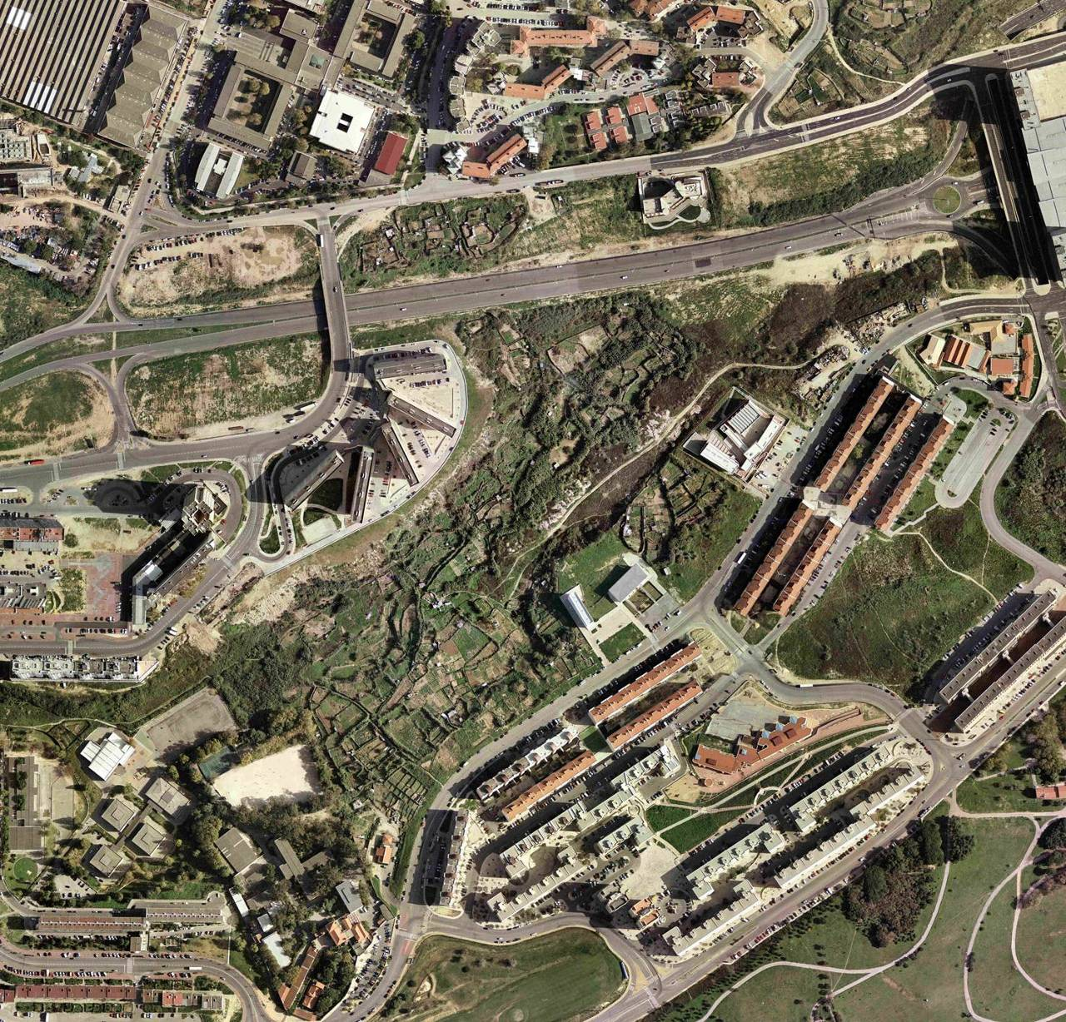
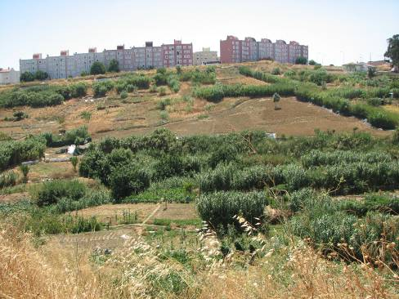
The ethics and the aesthetics of the allotment gardens
Aesthetics
At Chelas Valley the allotments gardens were illegal. The irrigation was made with unapropriate water , becoming a risk for the public health.
Agrarian Park of Vale de Chelas

Slide 21
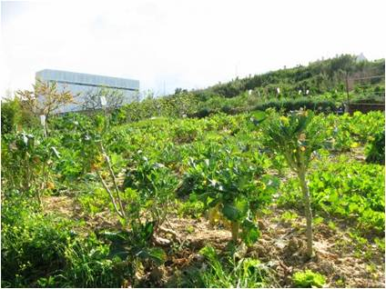
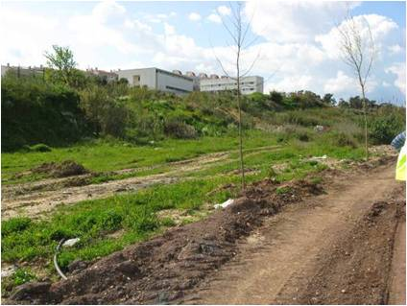
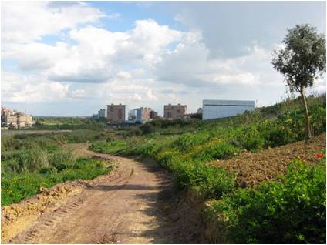
The ethics and the aesthetics of the allotment gardens
Aesthetics
Allotment Gardens – Vale de Chelas

Slide 22
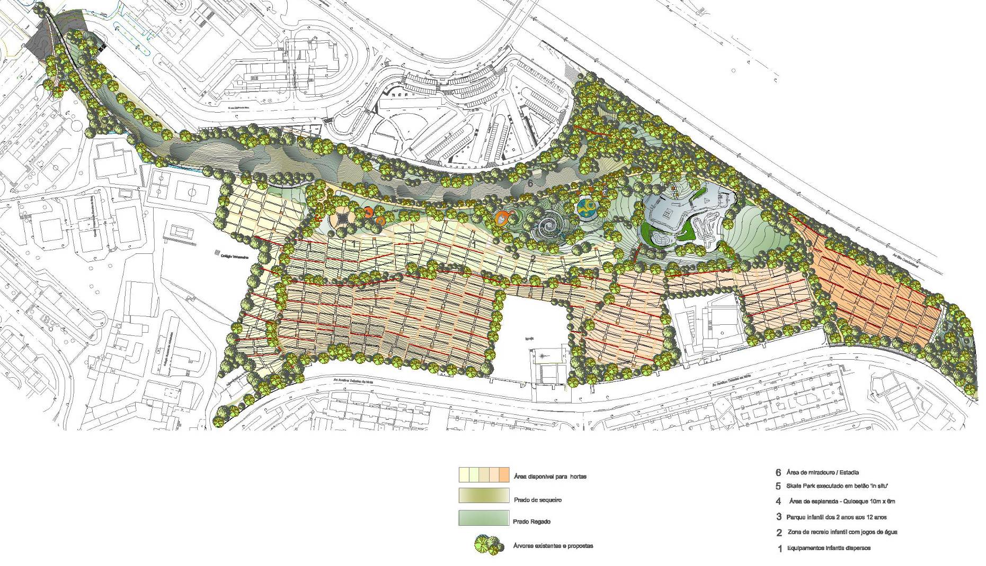
The ethics and the aesthetics of the allotment gardens
Aesthetics
Chelas Valley allotment gardens are now included on a designed Horticultural Park…
Agrarian Park of Vale de Chelas - Masterplan

Slide 23
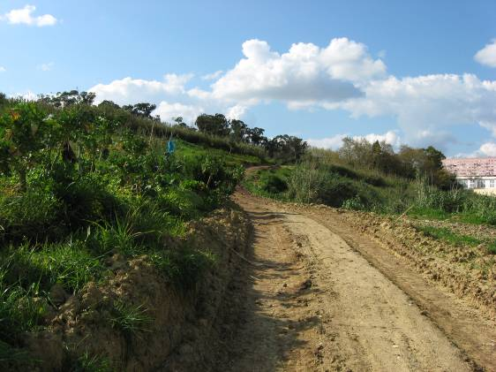
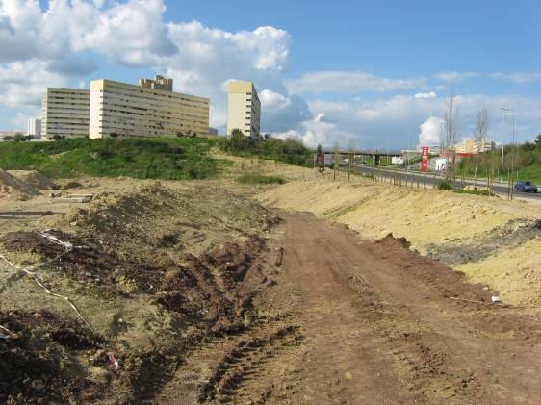
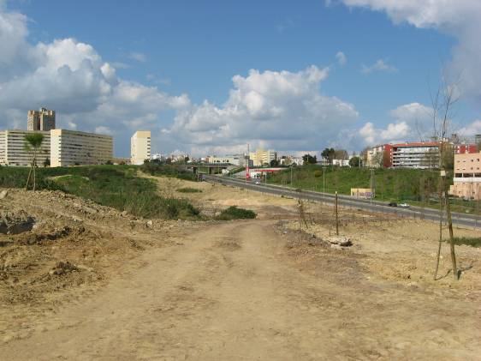
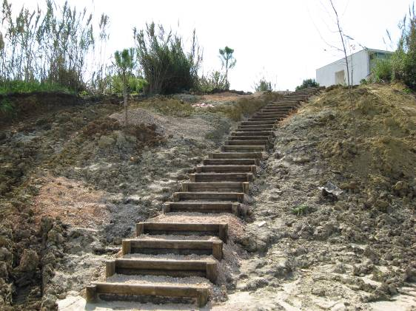
The ethics and the aesthetics of the allotment gardens
Aesthetics
…whose works were initiated with the placement of infrastructure for sanitation

Slide 24
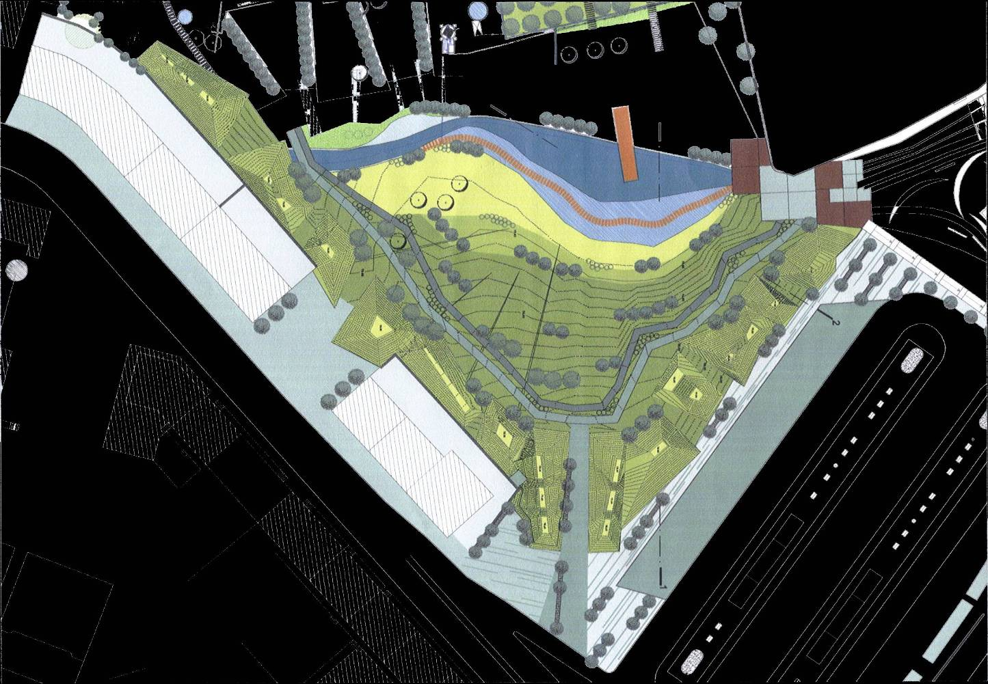
The ethics and the aesthetics of the allotment gardens
Aesthetics
Quinta da Granja – Urban Park– Phase 1

Slide 25
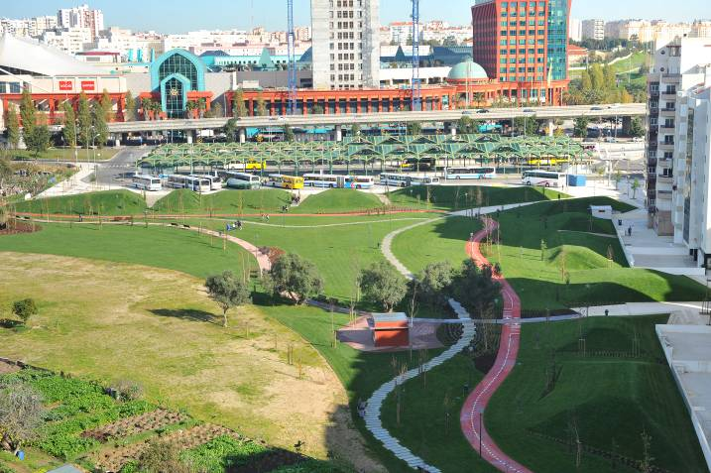
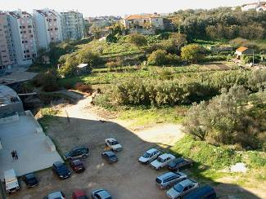
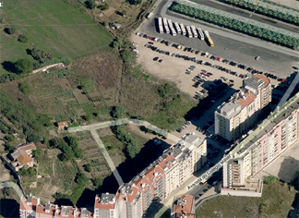
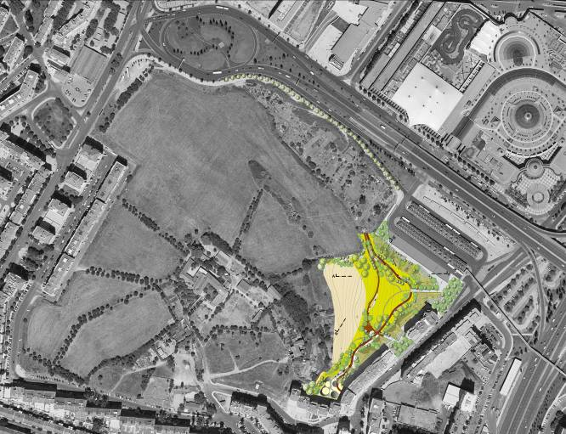
The ethics and the aesthetics of the allotment gardens
Aesthetics
Quinta da Granja – Urban Park – pathways and corridors

Slide 26
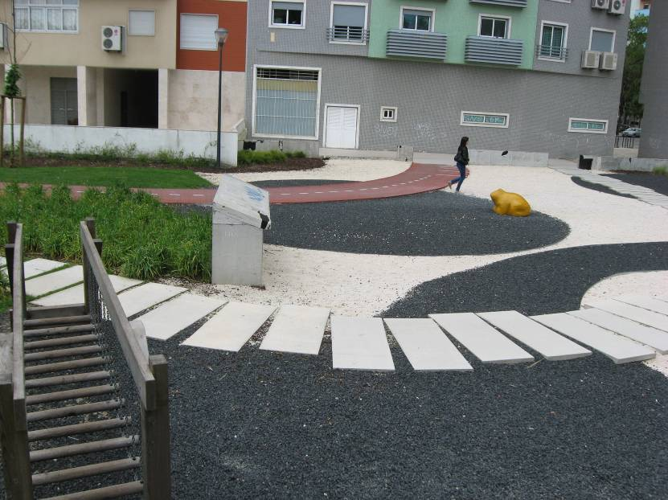
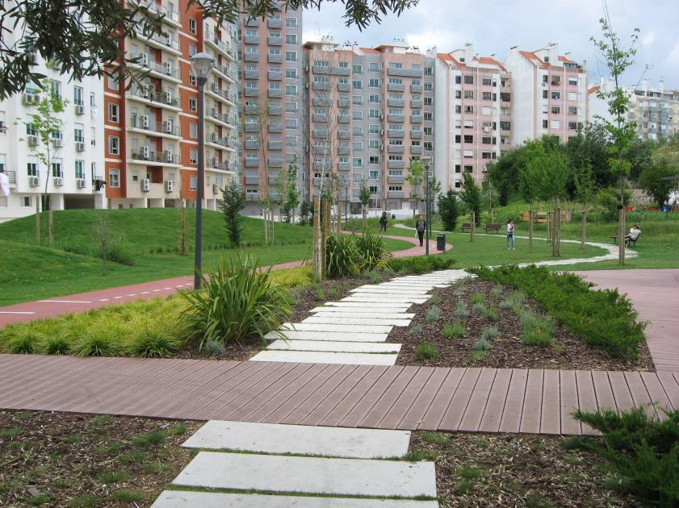
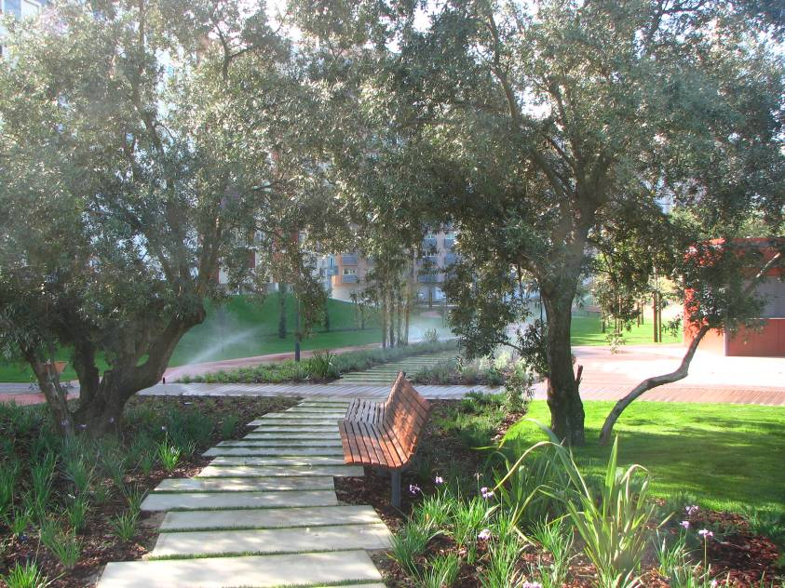
The ethics and the aesthetics of the allotment gardens
Aesthetics
Quinta da Granja – Urban Park – pathways and corridors

Slide 27
The ethics and the aesthetics of the allotment gardens
Aesthetics
Quinta da Granja – Urban Park – pathways and corridors

Slide 28
The ethics and the aesthetics of the allotment gardens
Aesthetics
Both Parks are strategically integrated in the green structure of Lisbon and in the Green Plan for the city
Strategic Plan for the public space of Lisbon

Slide 29
The ethics and the aesthetics of the allotment gardens
Aesthetics
Through routes and corridors this Plan establishes a connection between points and surfaces considered essential to the ecological and aesthetical balance of the city

