Slide 1
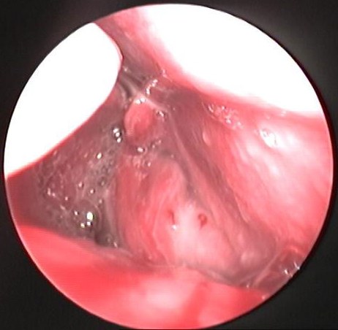
Canine Nasal Aspergillosis: review of diagnostic and therapeutic challenges about a case report
Santos, R.X.^{1,2}; Miranda, S.¹; Lavrador, C.² & Duarte, E.L.²
1 - Hospital Veterinário do Baixo-Vouga. Estrada Nacional 1, 355, 3750-742 Águeda, Portugal.
2 - Universidade de Évora, Escola de Ciências e Tecnologia, Departamento de Medicina Veterinária & ICAAM - Apartado 92-7002 Évora códex, Portugal
Introduction
Unlike humans, in which pulmonary aspergillosis is the most common clinical presentation, dogs usually present with a sinonasal or, more infrequently, a disseminated aspergillosis. Canine sinonasal aspergillosis (SNA) primarily affects young to middle-aged, mesaticephalic or dolichocephalic immunocompetent dogs. Even if it remains an uncommon condition, SNA is the second most common cause of purulent nasal discharge after intranasal neoplasia. Several diagnostic tools are available including immune-based tests and culture, nonetheless, rhinoscopy and histopathology are among the most reliable.
Case description
A ten year old male German Shepherd Dog presented with a history of chronic coughing, recently coupled by repetitive sneezing and reverse sneezing. There were no signs of systemic disease. Accounting for the most probable aetiologies of that unspecific presentation, amongst them inflammatory, infectious and allergic, the initial prescribed treatment was a non steroidal anti-inflammatory drug (NSAID) (i.e., meloxicam, 0.1 mg/kg q24h) for one week and antibiotic therapy with doxycycline (5 mg/kg q12h) for 15 days. In the end of the treatment signs of unilateral right epistaxis were observed and the animal was hospitalized. Haemorrhage was promptly stopped by topical adrenaline. No history of anticoagulant rodenticide use was recorded. A complete blood count and biochemestry revealed no significant changes and immune based tests for Dirofilaria sp., Leishmania sp. and Erlichia canis resulted all negative. Rhinoscopy was then performed. It revealed a congestive and hyperaemic nasopharynx with a seropurulent discharge and a purulent discharge in the right nasal cavity, coupled with signs of turbinate osteolysis. No fungal plaques were observed. Histopatology and culture and sensitivity (C&S) samples were collected. Doxycycline was stopped and the therapy was changed to a fluoroquinolone/beta-lactamic association, namely amoxycillin + clavulanate (18 mg/kg q12h) and enrofloxacin (5 mg/kg q24h) with an anti-inflammatory dose of prednisolone (0.5 mg/kg q12h and then q24h), until laboratory results. Histopathology of mucosal biopsy performed during rhinoscopy revealed a pyogranulomatous inflammation with no hyphae or neoplastic cells. Microbiology revealed a coagulase positive Staphylococcus sp. infection.
Although sneezing significantly decreased with treatment, nasal discharge became more abundant and was associated with a progressive nasal planum depigmentation. This led to the suspicion of SNA. A computerized tomography scan (CT) was performed. CT showed extensive turbinate osteolysis with intact cribiform plate. These findings supported the diagnosis of canine SNA and, as there was crifriform plate integrity, showed that a sinusotomy would be possible.
This procedure included sinusal washing with sterile 0.9% saline solution and the application of a 1% clotrimazole ointment on each frontal sinus. During surgery, aseptic collection of sinusal content was performed for a second bacterial C&S and also fungal culture. During the 10 days after surgery, epistaxis progressively diminished until complete remission. Bacterial C&S revealed a multiresistant Escherichia coli infection, which dictated the antibiotic change to pradofloxacin (3 mg/kg Q24h until clinical signs remission), solely. Fungal culture revealed the growth of Aspergillus sp. In the following weeks complete recover was considered, as nasal planum depigmentation reverted and a slight right nasal serosal discharge was occasionally recorded.
Discussion
ASN diagnosis remains challenging even for the skilled veterinary surgeon, as clinical presentation denotes a set of unspecific upper airway signs. In the presence of immunocompetent dogs, with no history of trauma or systemic disease, ASN is rarely considered a differential diagnosis, particularly if not supported by the observation of fungal plaques by rhinoscopy and absence of histopathological and microbiological confirmation. Also, epistaxis is far more frequently the sign of other vector borne infectious or parasitic diseases, or neoplasia. In this case, Aspergillus sp. culture was only positive when samples were collected during sinusotomy and empirical treatment. The whole diagnostic investigation lasted for approximately 4 months. This case has proven that a wise clinical judgement and a comprehensive differential diagnosis in the absence of laboratory confirmation is still critical for ASN successful management.
Figure 1 – Rhynoscopic view of the right nasal cavity. There is cavitation due to extensive turbinate ostelolysis and mucosal hyperaemia secondary to the local inflammatory process.
Video 1 – CT frontal slices denoting right turbinate osteolysis with accummulation of content with soft tissue attenuation on both right nasal cavity, maxillary recess, and forntal sinus, right frontal bone hyperostosis and cribriform plate integrity.
Day MJ, Peeters D, Clercx C, Barrs VRD (2012) Chapter 62: Aspergillosis and Penicilliosis, In Infectious diseases of the dog and cat, 4th Edition, ed. Greene CE, Elsevier Saunders, Saint Louis, Missouri, ISBN 978-1-4160-6130-4, pp. 651-666.
Sissener TR, Bacon NJ, Friend E, Anderson DM, White RAS (2006) Combined clotrimazole irrigation and depot therapy for canine nasal aspergillosis. Journal of Small Animal Practice. 47(6): 312-315.
Copyright © 2018 of:
Santos, R.X. – ruixaviersantos@gmail.com
Miranda, S – sonia.miranda@onevetgroup.pt
Lavrador, C. – clavrador@uevora.pt
Duarte, E.L. – emld@uevora.pt
Notes:
Please export the PowerPoint document as a PDF (File – Save as – PDF) and upload the PDF into the system. Please use the font in the document or a similar one and do not use a font size smaller than 16.

